Slide 1

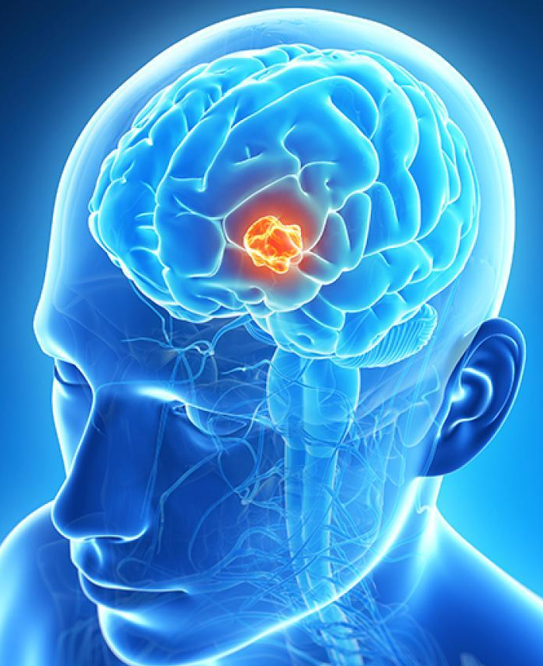
AutoSeg
For better segmentation
Ori Chyoot , Roy Hirsch

Slide 2
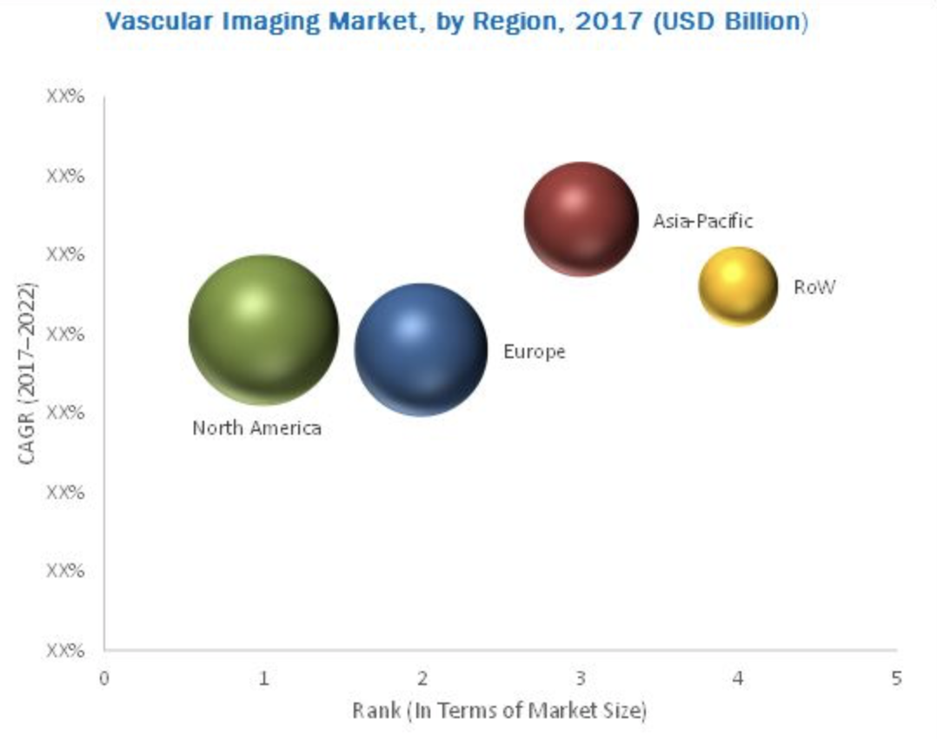
Target market and opportunity
Our potential clients are hospitals, there are 5,534 hospitals in the US.
The global vascular imaging market is 4.35 Billion USD in 2017.
The global magnetic resonance imaging market is 6,611 Million USD in 2017.
https://www.transparencymarketresearch.com/pressrelease/magnetic-resonance-imaging-market.htm
https://www.marketsandmarkets.com/Market-Reports/vascular-imaging-market-247188200.html
North America is the leading market with estimated revenue share of 3,212.1 Million USD by 2022

Slide 3
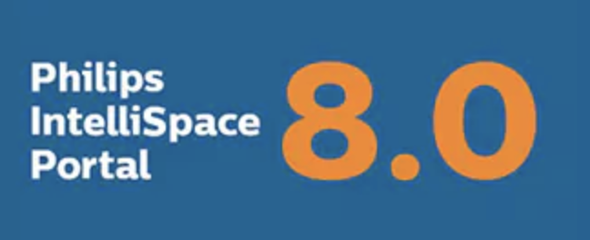


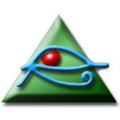
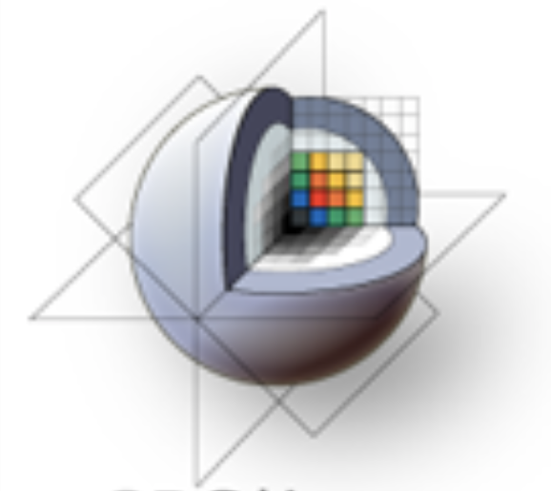
Competitive analysis
More convenient
IntelliSpace Portal 8.0
Brainsuite
More expensive
syngo.via
OsiriX
3Dslicer
https://www.transparencymarketresearch.com/pressrelease/magnetic-resonance-imaging-market.htm
https://www.marketsandmarkets.com/Market-Reports/vascular-imaging-market-247188200.html
North America is the leading market with estimated revenue share of 3,212.1 Million USD by 2022

Slide 4
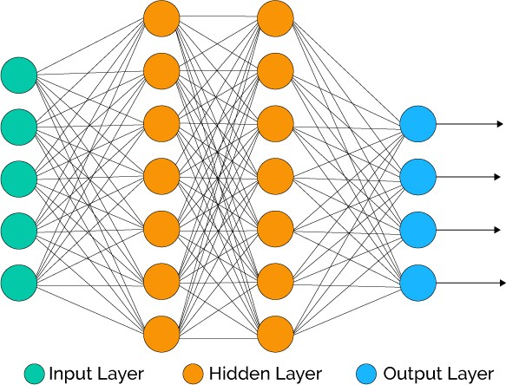
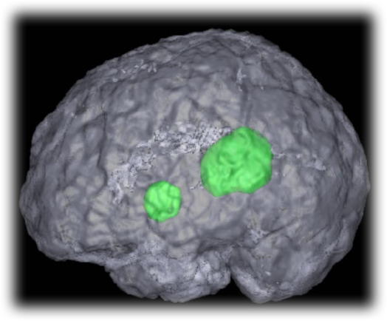
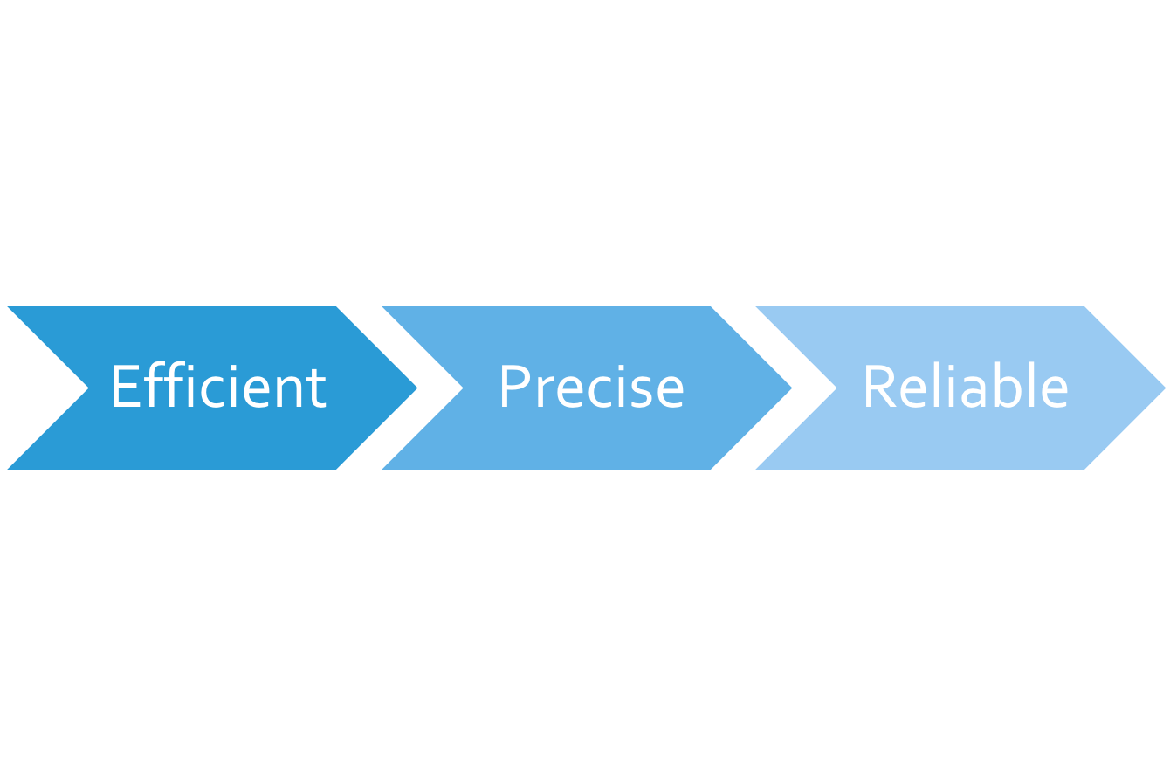
The solution
Advanced neural network for semantic segmentation of tumor tissues.
https://www.transparencymarketresearch.com/pressrelease/magnetic-resonance-imaging-market.htm
https://www.marketsandmarkets.com/Market-Reports/vascular-imaging-market-247188200.html
North America is the leading market with estimated revenue share of 3,212.1 Million USD by 2022

Slide 5
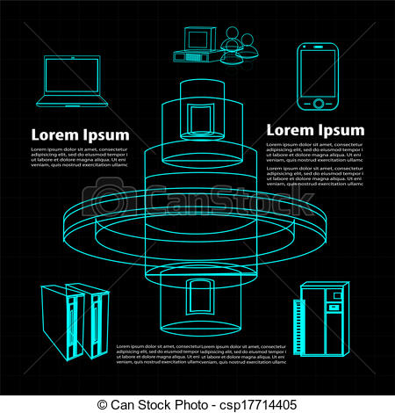
The Revenue Model
SaaS with yearly subscriptions:
Off-the-shelf
System
Basic rate
Custom-mode
System
Advanced rate
https://www.transparencymarketresearch.com/pressrelease/magnetic-resonance-imaging-market.htm
https://www.marketsandmarkets.com/Market-Reports/vascular-imaging-market-247188200.html
North America is the leading market with estimated revenue share of 3,212.1 Million USD by 2022

Slide 6
Traction:
Milestones for the next year
200 business offers
10 clients of custom-mode product
30 clients of off-the-shelf product
30% monthly growth
https://www.transparencymarketresearch.com/pressrelease/magnetic-resonance-imaging-market.htm
https://www.marketsandmarkets.com/Market-Reports/vascular-imaging-market-247188200.html
North America is the leading market with estimated revenue share of 3,212.1 Million USD by 2022

Slide 7
Marketing & Growth Strategy :
May 2018: Release free software version
Conducting worldwide seminars
June 2018: Subscriptions offers to potential costumers in the US
Sep 2018: Subscriptions offers to potential costumers in Europe
Dec 218: Offers to potential costumers in Asia and Africa
10 clients of custom-mode product
https://www.transparencymarketresearch.com/pressrelease/magnetic-resonance-imaging-market.htm
https://www.marketsandmarkets.com/Market-Reports/vascular-imaging-market-247188200.html
North America is the leading market with estimated revenue share of 3,212.1 Million USD by 2022

